Slide 1
Greedy Algorithms

Slide 2
Optimization problems
An optimization problem is one in which you want to find, not just a solution, but the best solution
A “greedy algorithm” sometimes works well for optimization problems
A greedy algorithm works in phases. At each phase:
You take the best you can get right now, without regard for future consequences
You hope that by choosing a local optimum at each step, you will end up at a global optimum

Slide 3
Greedy Approach
General method: Given n inputs choose a subset that satisfies some constraints
A subset that satisfies the constraints is called a feasible solution.
A feasible solution that maximizes or minimizes a given (objective) function is said to be optimal.
Often it is easy to find a feasible solution but difficult to find the optimal solution.
The greedy method suggests that one can devise an algorithm that works in stage. At each stage a decision is made whether a particular input is in the optimal solution. This is called subset paradigm.

Slide 4
Example
Example: Your Train breaks down in a desert and you decide to walk to nearest town. You have a rucksack but which objects should you take with you ?
Feasible: Any set of objects is a feasible solution provided that they are not too heavy, fit in the rucksack and will help you survive (these are constraints).
An optimal solution is the one that maximizes or minimizes something
One that minimizes the weight carried
One that fills the rucksack completely (maximize)
One that ensures the most water is taken etc.

Slide 5
Example
Example: You are writing a computer game and need to store your .wav, .jpg, and .mpg files on a set of CD-roms. The constraint is the length of files and the size of the CD (capacity)
A feasible solution is any combination that fits.
An optimal one is the order that minimizes the access time for each file.
In this case you will have the minimum delay for the player.
Hence you might sell more games.
Have smoother game action.

Slide 6
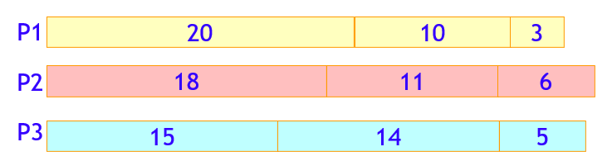
Scheduling Problem – Solution 1
You have to run nine jobs, with running times of 3, 5, 6, 10, 11, 14, 15, 18, and 20 minutes
You have three processors on which you can run these jobs
You decide to do the longest-running jobs first, on whatever processor is available
Time to completion: 18 + 11 + 6 = 35 minutes
This solution isn’t bad, but we might be able to do better

Slide 7
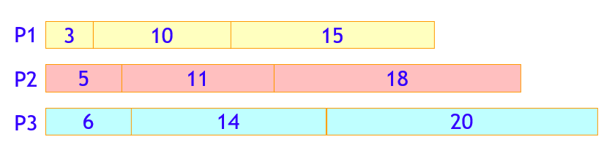
Scheduling Problem – Solution 2
What would be the result if you ran the shortest job first?
Again, the running times are 3, 5, 6, 10, 11, 14, 15, 18, and 20 minutes
That wasn’t such a good idea; time to completion is now 6 + 14 + 20 = 40 minutes
Note, however, that the greedy algorithm itself is fast
All we had to do at each stage was pick the minimum or maximum

Slide 8
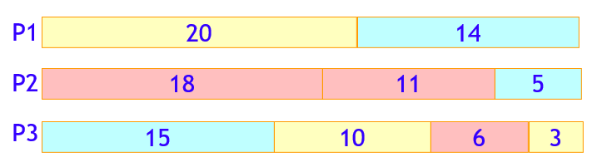
Scheduling Problem – Optimal Solution
How do we find such a solution?
One way: Try all possible assignments of jobs to processors
Unfortunately, this approach can take exponential time

Slide 9
Task Scheduling
The task scheduling problem we consider here is to schedule all the tasks in T on the fewest machines possible in a nonconflicting way.
Suppose we are given a set T of n tasks such that each task i has a start time, si, and a finish time, fi (where si < fi). Task i must start at time si and must finish by time fi.
Each task must be performed on a machine and each machine can execute only one task at a time. Two tasks i and j are said to be nonconflicting if they do not overlap in time, i.e., fi ≤ sj or fj ≤ si.
Clearly, two tasks can be scheduled to be executed on the same machine only if they are nonconflicting.

Slide 10
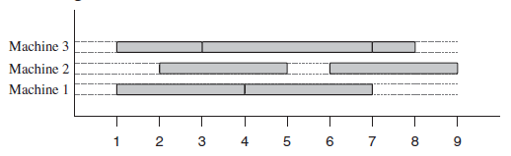
Task Scheduling – Example 1
Find a solution to the task scheduling problem, for tasks whose collection of pairs of start times and finish times is
{(1, 3), (1, 4), (2, 5), (3, 7), (4, 7), (6, 9), (7, 8)}.

Slide 11
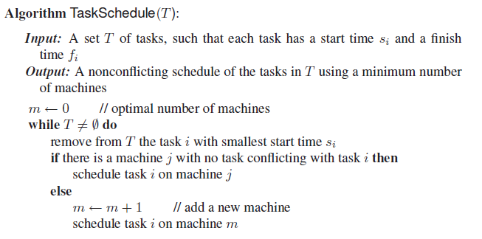
Task Scheduling - Algorithm
O(nlogn)

Slide 12
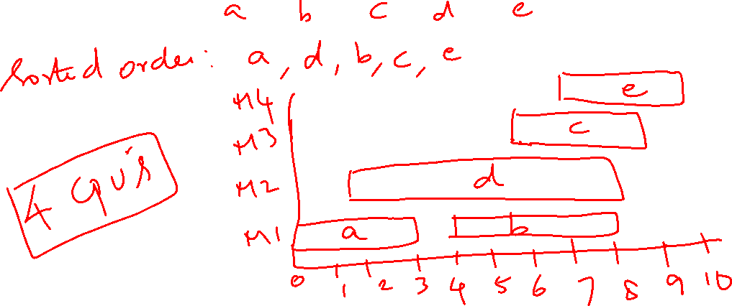
Example 2
Find the number of CPUs needed to schedule the jobs with start time-end time pair as {(0, 3), (4, 8), (6, 9), (2, 8), (7, 10)}

Slide 13
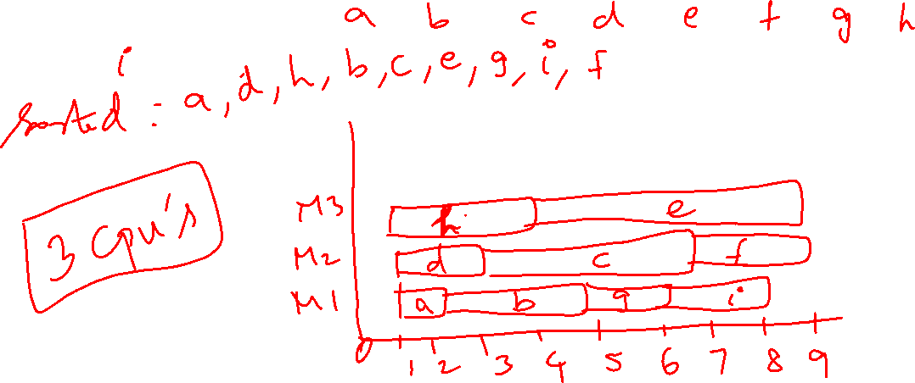
Example 3
Find the number of machines needed to schedule the jobs with start time-end time pair as {(1,2), (2, 5), (3, 7), (1, 3), (4, 9), (7, 9), (5, 6), (1, 4), (6, 8)}

Slide 14
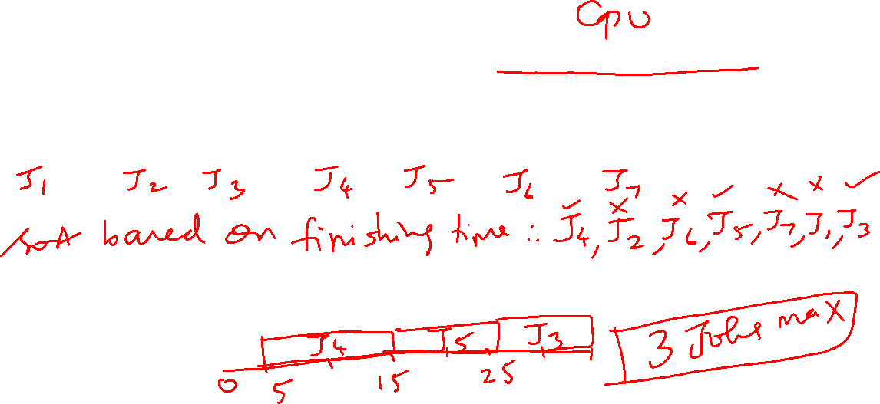
Job/Task Scheduling
Assuming there are N jobs that requires a single available resource for a certain period, find the maximum number of jobs that can avail the existing resource.
{(0, 35), (10, 20), (25, 35), (5, 15), (15, 25), (13, 20), (24, 27)}

Slide 15
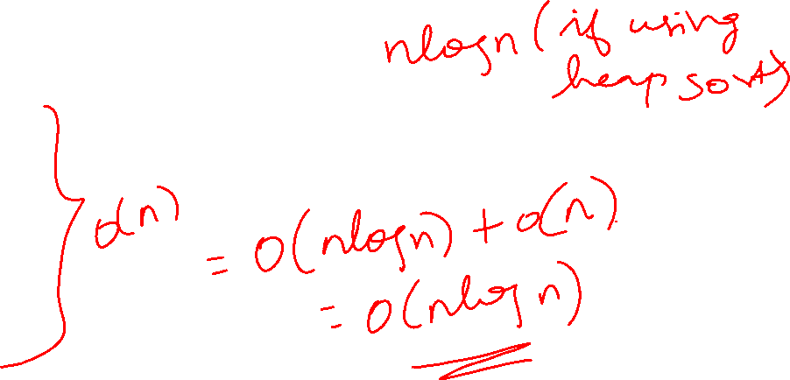
Job/Task Scheduling - Algorithm
Order the jobs based on finishing time fi
n=length of the jobs
A = {J1}
k=1
for m in 2 to n do
if (s[m]>=f[k])
A=A U {Jm}
k=m
return A O(nlogn)

Slide 16
Knapsack problem
0-1 Knapsack
Given weights and values of n items, put these items in a knapsack of capacity W to get the maximum total value in the knapsack.
You cannot break an item, either pick the complete item or don’t pick it (0-1 property).
Fractional knapsack
Given weights and values of n items, we need to put these items in a knapsack of capacity W to get the maximum total value in the knapsack.
In Fractional Knapsack, we can break items for maximizing the total value of knapsack.

Slide 17
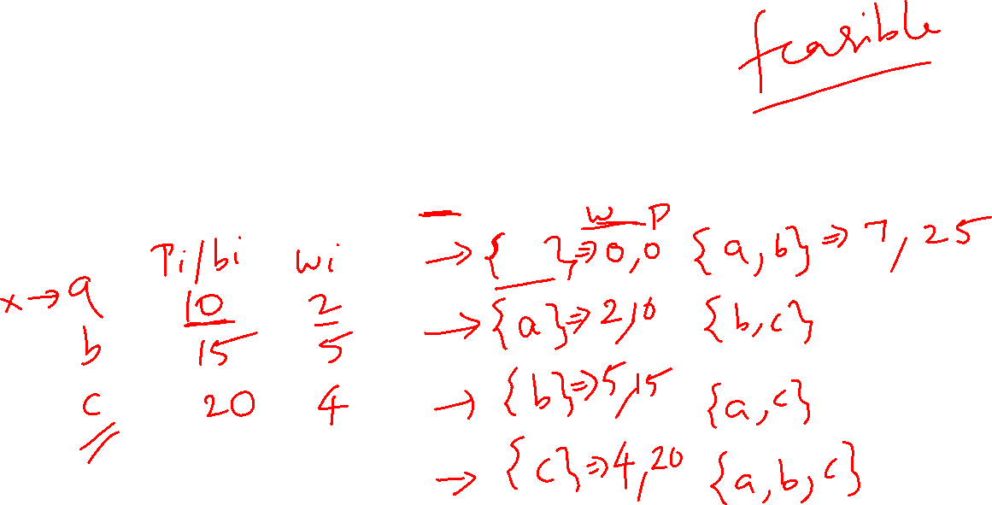
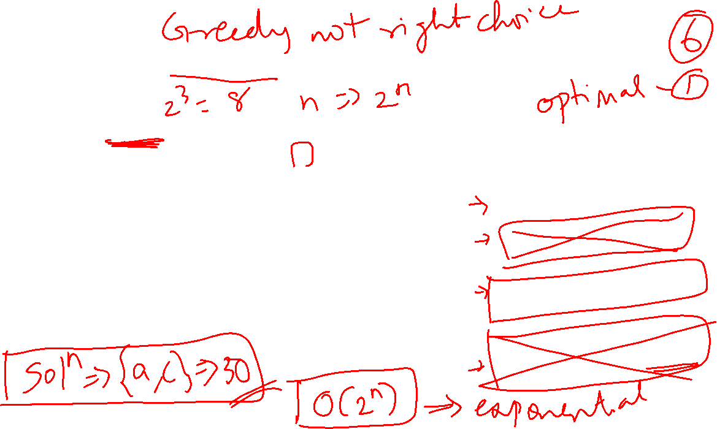
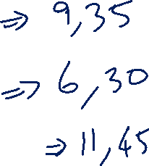

Example 1 – 0/1 knapsack problem
Consider 3 items with the benefit-weight pairs given as (10, 2), (15, 5), (20, 4) with sack capacity 8. Solve the 0-1 knapsack problem and provide an optimal solution.

Slide 18
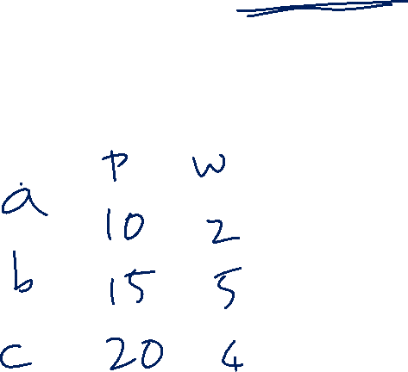
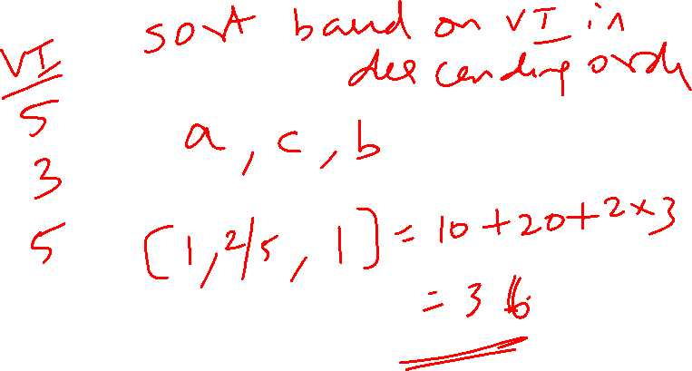
Example 1 – Fractional Knapsack
Consider 3 items with the benefit-weight pairs given as (10, 2), (15, 5), (20, 4) with sack capacity 8. Solve the fractional knapsack problem and provide an optimal solution.

Slide 19
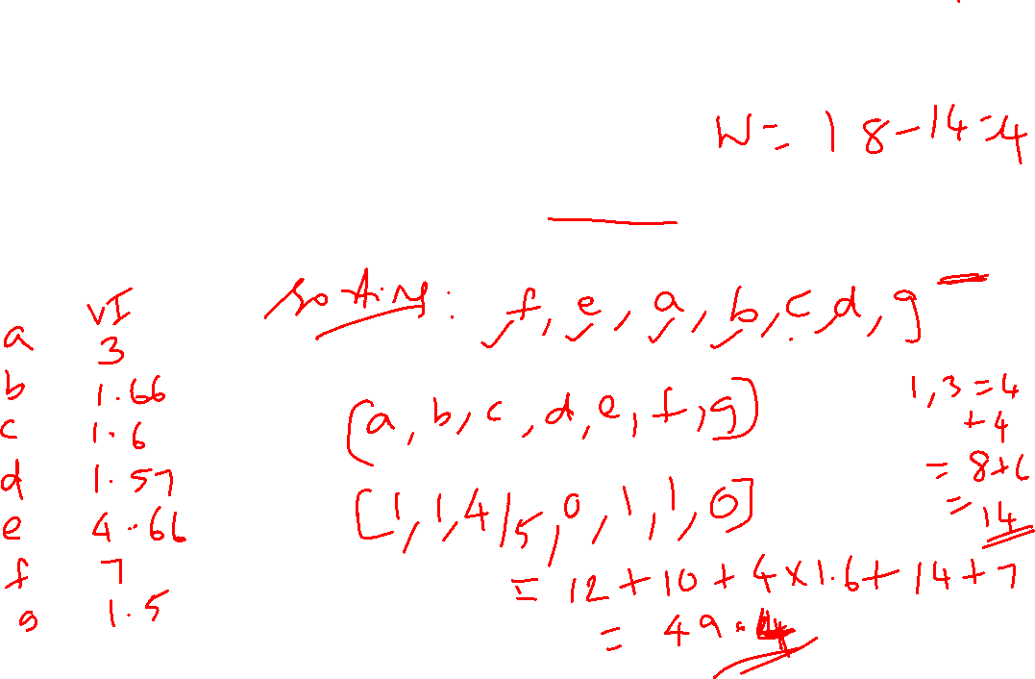
Example 2 – Fractional Knapsack
Let S = {a, b, c, d, e, f, g} be a collection of objects with benefit-weight values, a: (12, 4), b: (10, 6), c: (8, 5), d: (11, 7), e: (14, 3), f : (7, 1), g: (9, 6). What is an optimal solution to the fractional knapsack problem for S assuming we have a sack that can hold objects with total weight 18? Show your work.

Slide 20
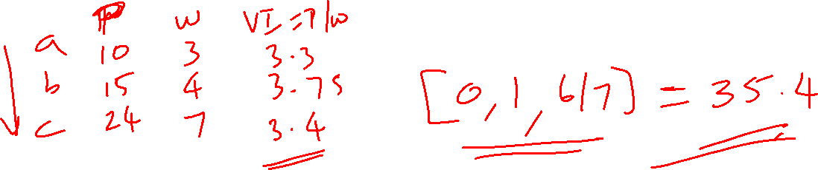
Example 3 – Fractional Knapsack
Solve the fractional knapsack problem with profit-weight pairs as (10,3), (15, 4), (24, 7) and sack capacity 10.

Slide 21
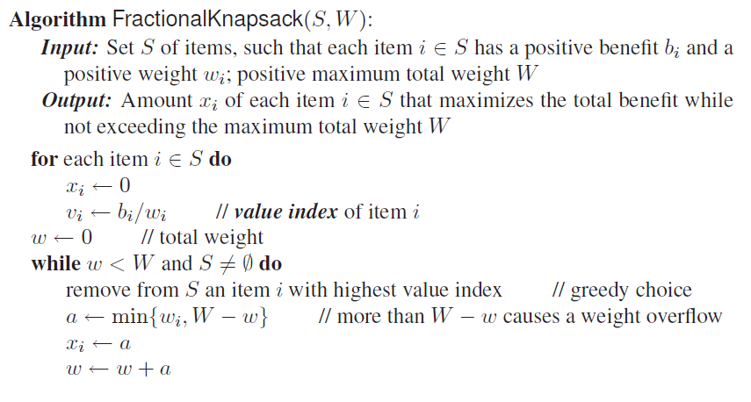
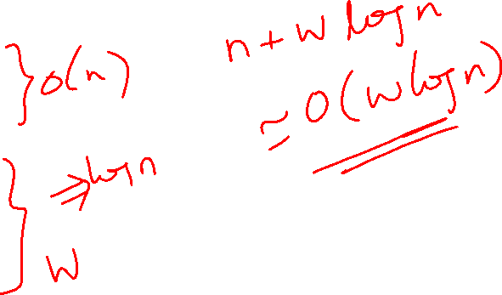
Fractional knapsack algorithm
Profit 0 // for profit calculation
Profit Profit+x_{i}*v_{i}

Slide 22
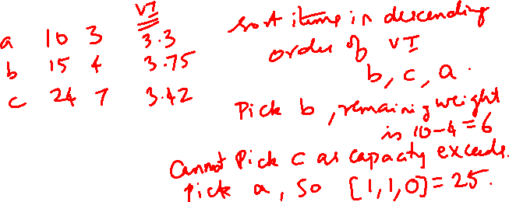
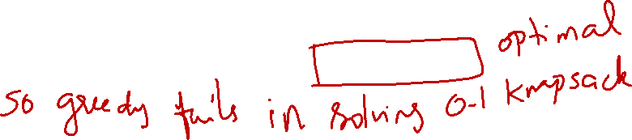
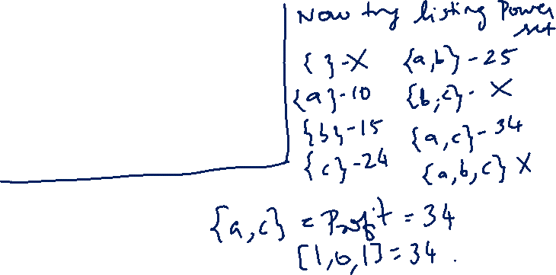
Value Index for 0-1 Fails…
Consider the profit-weight pairs (10,3), (15, 4), (24, 7) with sack capacity 10.

Slide 23
Huffman Coding
Huffman coding is a lossless data compression algorithm.
The idea is to assign variable-length codes to input characters, lengths of the assigned codes are based on the frequencies of corresponding characters.
The most frequent character gets the smallest code, and the least frequent character gets the largest code.
The variable-length codes assigned to input characters are Prefix codes

Slide 24
What is Prefix code?
Let us understand prefix codes with a counter example.
Let there be four characters a, b, c and d, and their corresponding variable length codes be 00, 01, 0 and 1.
This coding leads to ambiguity because code assigned to c is the prefix of codes assigned to a and b.
If the compressed bit stream is 0001, the de-compressed output may be “cccd” or “ccb” or “acd” or “ab”.

Slide 25
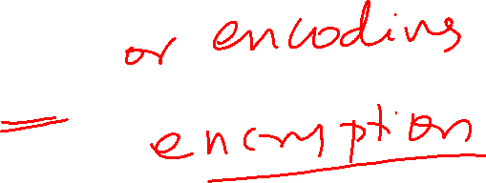
How to construct Huffman coding?
Step 1: Create a leaf node for each unique character and build a min heap of all leaf nodes
Min Heap is used as a priority queue. The value of frequency field is used to compare two nodes in min heap. Initially, the least frequent character is at root
Step 2: Extract two nodes with the minimum frequency from the min heap.
Step 3: Create a new internal node with a frequency equal to the sum of the two nodes frequencies. Make the first extracted node as its left child and the other extracted node as its right child. Add this node to the min heap.
Step 4: Repeat steps#2 and #3 until the heap contains only one node. The remaining node is the root node and the tree is complete.

Slide 26
Example 1
Consider the frequencies of the alphabets in a document as given below. Find the minimum number of bits needed to represent the characters using normal method and compare it with Huffman algorithm.
Character | Occurrence (in lakhs)
A | 16
B | 6
C | 4
D | 8
E | 5
F | 2
G | 1
H | 3

Slide 27
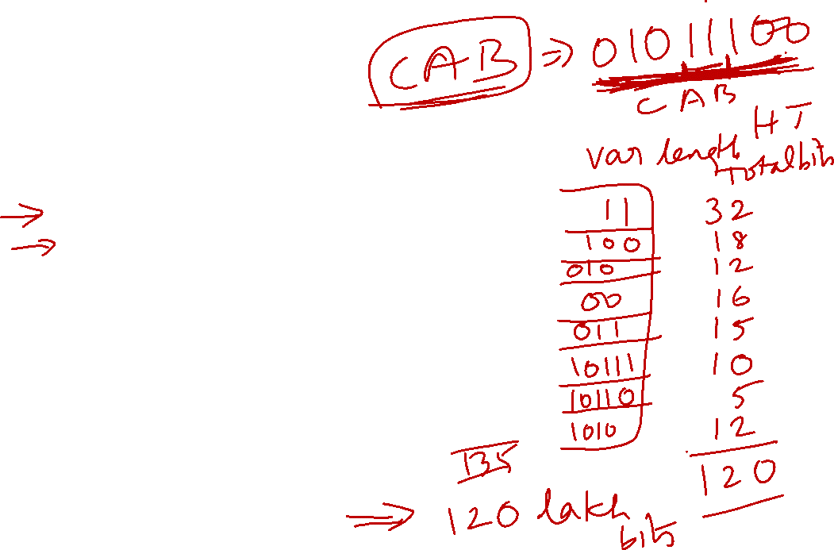
Example 1 - Solution
Character | Occurrence (in lakhs) | Bit codes used | Total No. of bits needed (in lakhs)
A | 16 | 000 | 48
B | 6 | 001 | 18
C | 4 | 010 | 12
D | 8 | 011 | 24
E | 5 | 100 | 15
F | 2 | 101 | 6
G | 1 | 110 | 3
H | 3 | 111 | 9
Total bits needed = 135 lakh bits

Slide 28
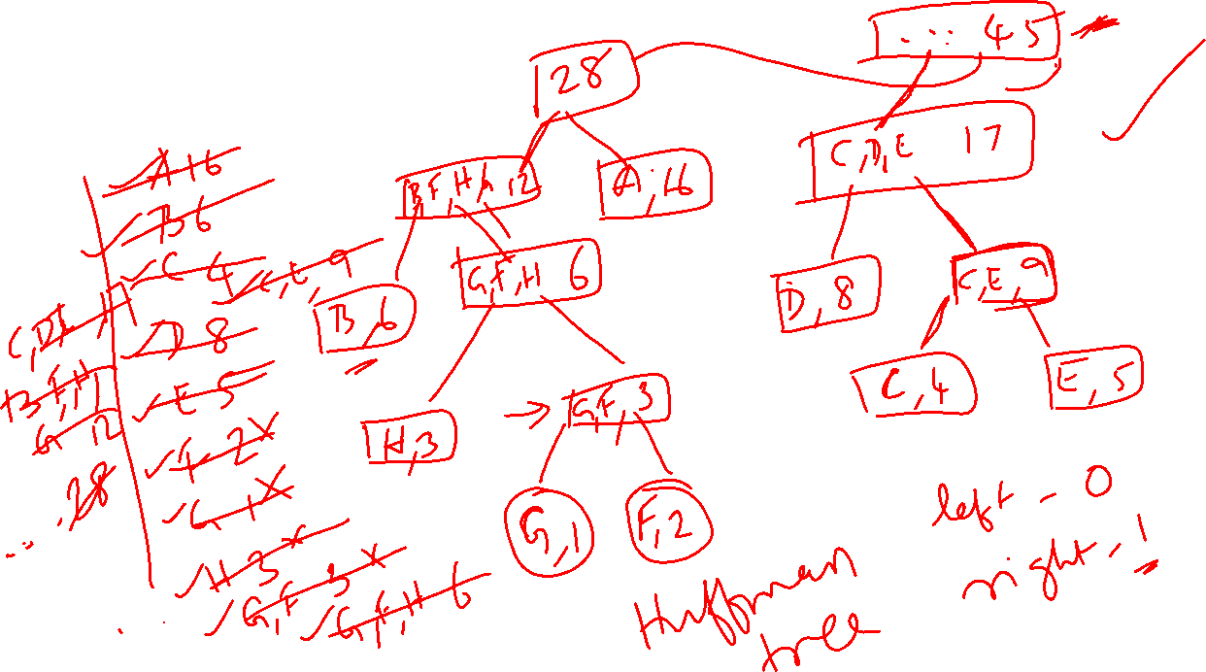
Example 1 – Huffman Coding

Slide 29
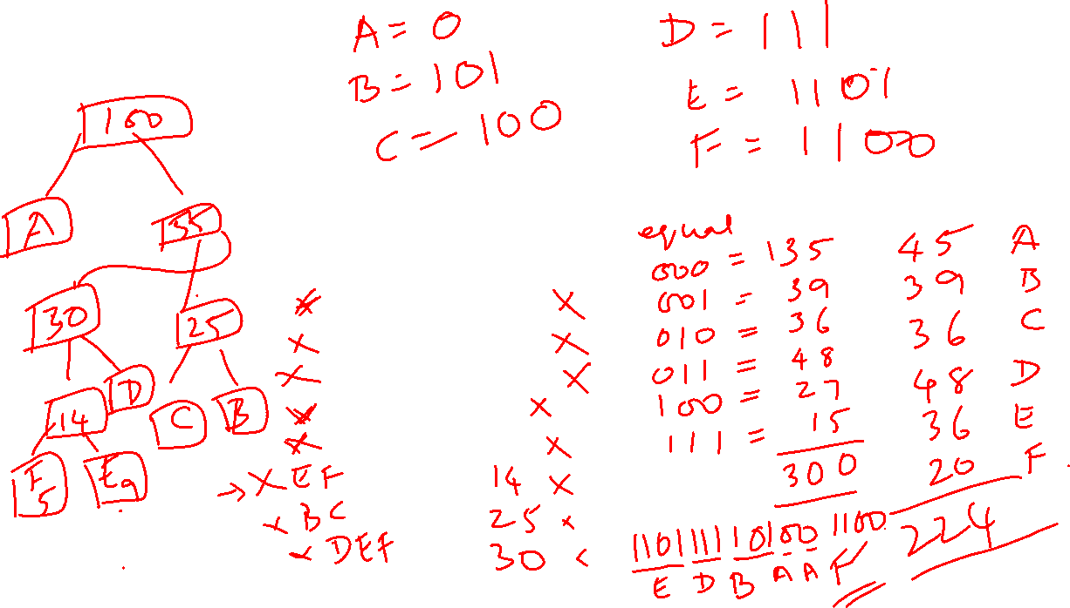
Example 2
Compare the normal coding with Huffman coding
Character | Occurrence (in lakhs)
A | 45
B | 13
C | 12
D | 16
E | 9
F | 5

Slide 30
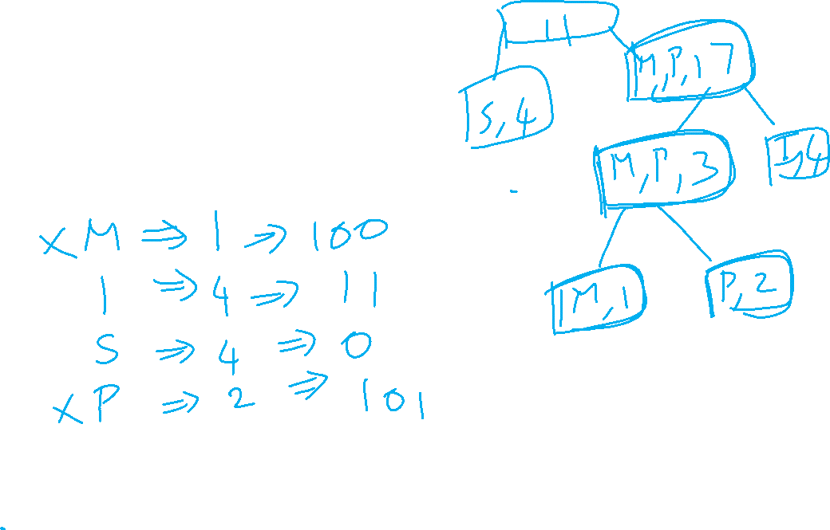
Example 3
Encode the characters in the word MISSISSIPPI

Slide 31
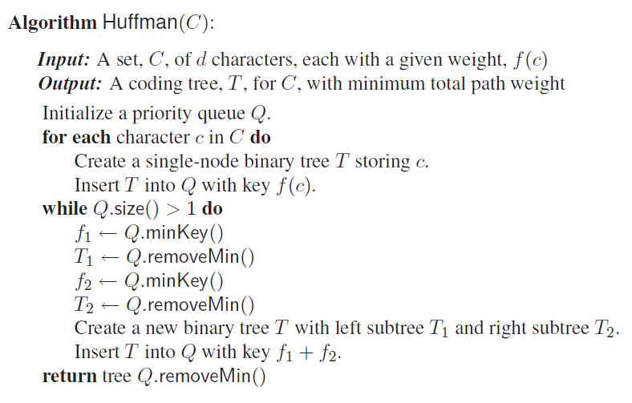
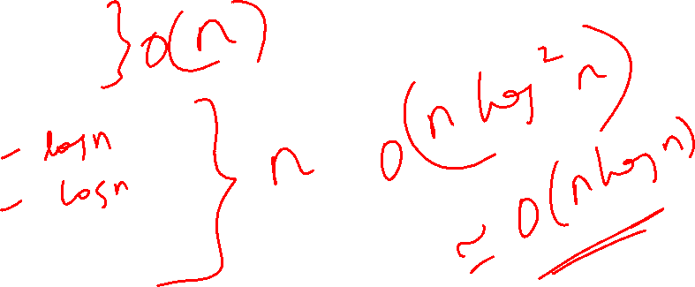
Huffman coding algorithm

Slide 32
Coin Changing Problem
Given a value N, if we want to make change for N cents, and we have infinite supply of each of S = { S1, S2, .. , Sm} valued coins, how many ways can we make the change? The order of coins doesn’t matter. Find the minimum number of coins to change.
For example, for N = 4 and S = {1,2,3}, there are four solutions: {1,1,1,1}, {1,1,2}, {2,2}, {1,3}. So output should be 4. Minimum is 2.
For N = 10 and S = {2, 5, 3, 6}, there are five solutions: {2,2,2,2,2}, {2,2,3,3}, {2,2,6}, {2,3,5} and {5,5}. So the output should be 5. Minimum is 2.

Slide 33
Example 1
Assume the coins available as {30, 20, 5, 1}, how many ways you can make the change for the amount 28?
Solution:
Sort the denominations in descending order and make change for the available amount. Say, pick 20, now remaining amount to make change is 28-20=8. Now pick the next highest denomination and repeat the steps. Solution is {20, 5, 1, 1, 1}

Slide 34
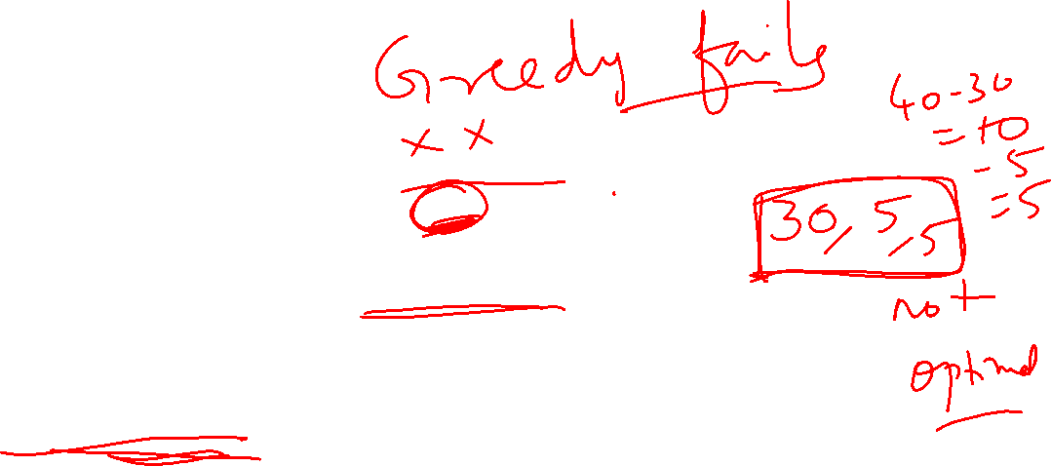
Example 2
Assume the coins available as {30, 20, 5, 1}, how many ways you can make the change for the amount 40?
Using greedy, Solution is {30, 5, 5}. So the total coins are 3.
But actually, solution could be {20, 20} with 2 coins.
Greedy algorithm fails in such cases as it fails to give an optimal solution.
Dynamic programming approach can be used to get an optimal solution.

Slide 35
Container Loading Problem
Loading a large ship with containers
Different containers have different sizes
Different containers have different weights
Goal To load the ship with the maximum # of containers
Container-loading problem is a kind of bin packing problem
Problem: Load as many containers as possible without sinking the ship!
The ship has the capacity c
There are m containers available for loading
The weight of container i is wi
Each weight is a positive number
The volume of container is fixed
Constraint: Sum of container weights < c

